Slide 1
“Site Visit” Video Tips
Filming on your smartphone device
Adapted from work by Jeremy Make

Slide 2
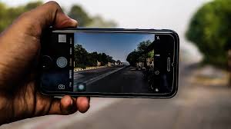
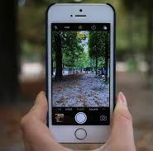
#1 Rule: Horizontal Videos ONLY

Slide 3
But first!
Make sure you have enough storage space on your phone to film
Remove unneeded photos/video/music files that take up a lot of space

Slide 4
Filming Tips
Keep a steady hand while filming - if you don’t have a tripod, hold the phone on both sides and keep your elbows close to your body.
Move slowly – if you’re panning around a room or moving down a hall, move slowly and steadily
Zoom by getting physically closer – don’t zoom in on the phone (physically move closer to what you want to get a larger image of)

Slide 5
Sound
Put your phone on airplane mode! This will keep any alert sounds from getting picked up by the microphone
Interviewing:
Be as close as possible to pick up the clearest sound you can of the interviewee speaking
Be in a space with zero ambient noise

Slide 6
Lighting
Film in bright areas - bring in lights to brighten up an area that isn’t lit well
Avoid shadows
Natural lighting from windows can help light up your subjects

Slide 7
Permission
Don’t forget to get permission of folks whose faces are being shown!
Get forms signed where appropriate (ie; for any patients featured)

Slide 8
B-Roll Footage Ideas – aka extra footage for interspersing!
5 seconds of your organization’s logo
Walking through the doors of your clinic
Spaces in the health center like the waiting room, call center, patient rooms, vitals area
Non-specific work, like staff on the phone, staff on a computer, staff using other technology, staff looking at data, staff in a meeting

Slide 9
More About Interviews on Camera
You’re still in horizontal mode!!

Slide 10
Framing: what the camera sees
Camera at eye level of subject
Keep camera still/steady as possible
Film about 2-3 feet away from subject
Subject’s eyes slightly higher than center
Tap phone screen once on the subject to focus and light

Slide 11
Sound – Silence is golden!
Eliminate all background noise during interview
Cameraperson should be silent too
Ask one, short, open-ended question, and then pause
Count to 10 after the subject appears to be done answering
Embrace the awkward; it’s filmic gold
Not a peep for 10 seconds
Only after 10 seconds should you stop recording

Slide 12
One last time…. Horizontal Videos ONLY

Slide 13
Sending footage to CCI
The file(s) will be too big to send via email
Upload to Google Drive, Dropbox or something similar and send the sharing link to:
meaghan@careinnovations.org
mobrien@careinnovations.org
kendra@careinnovations.org

